Slide 1

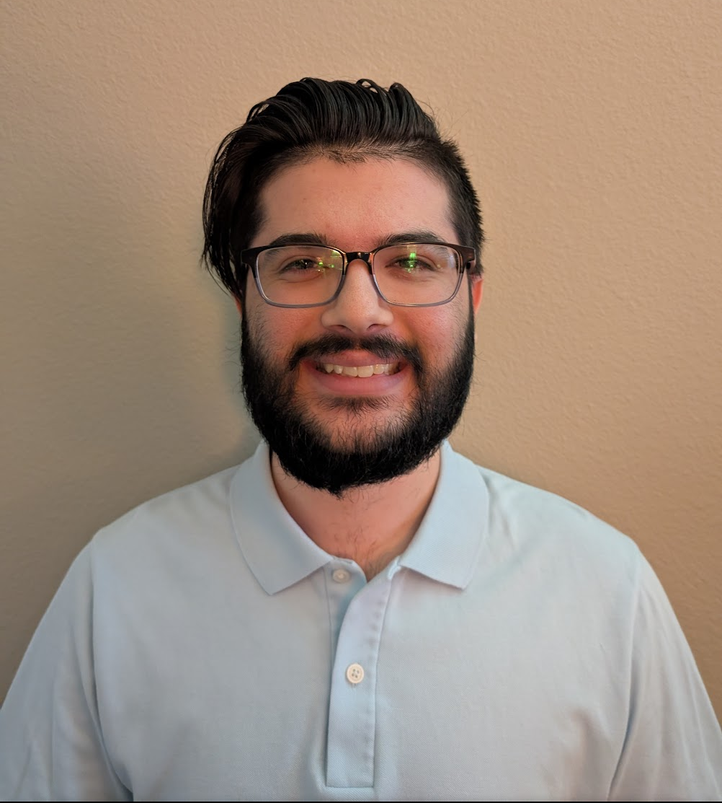
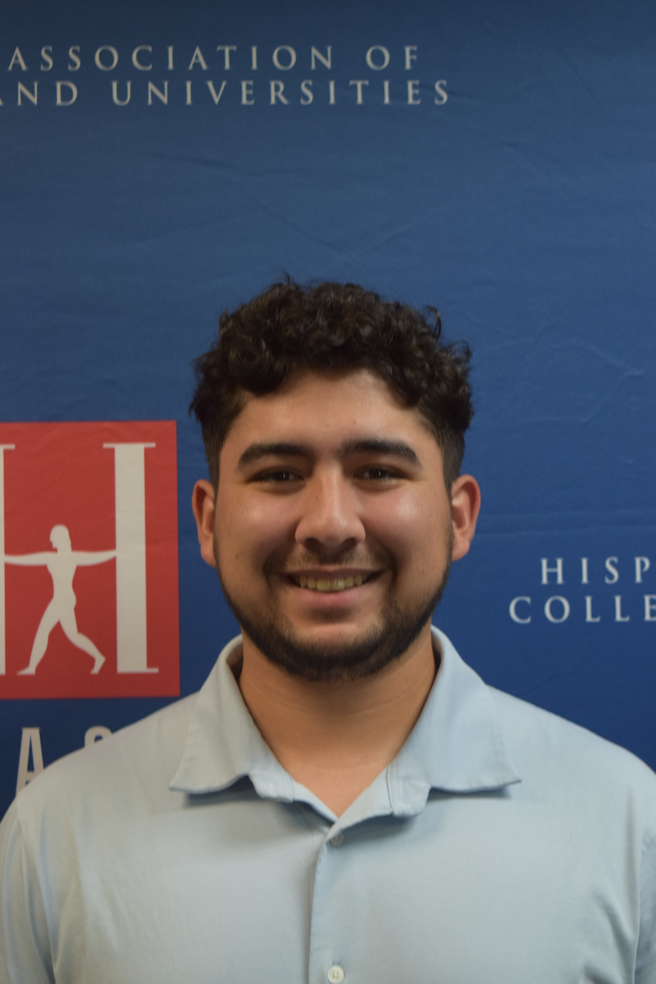
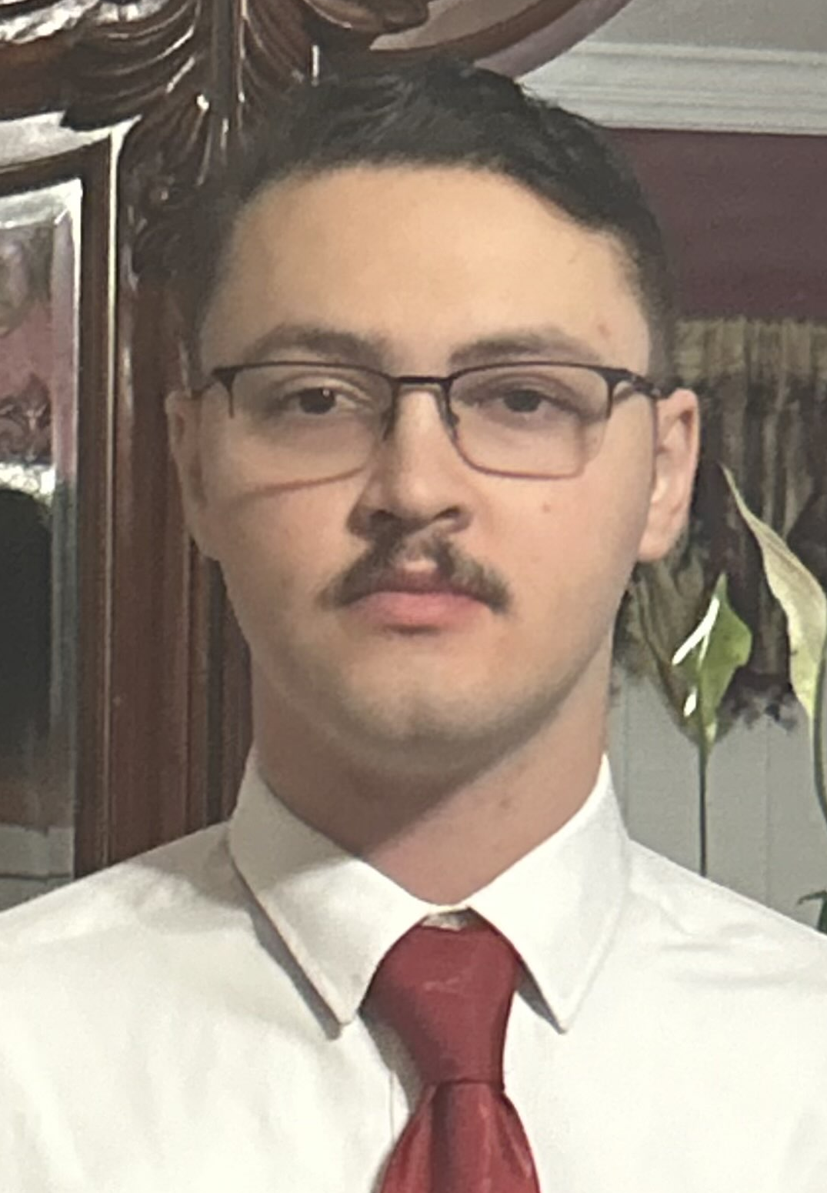
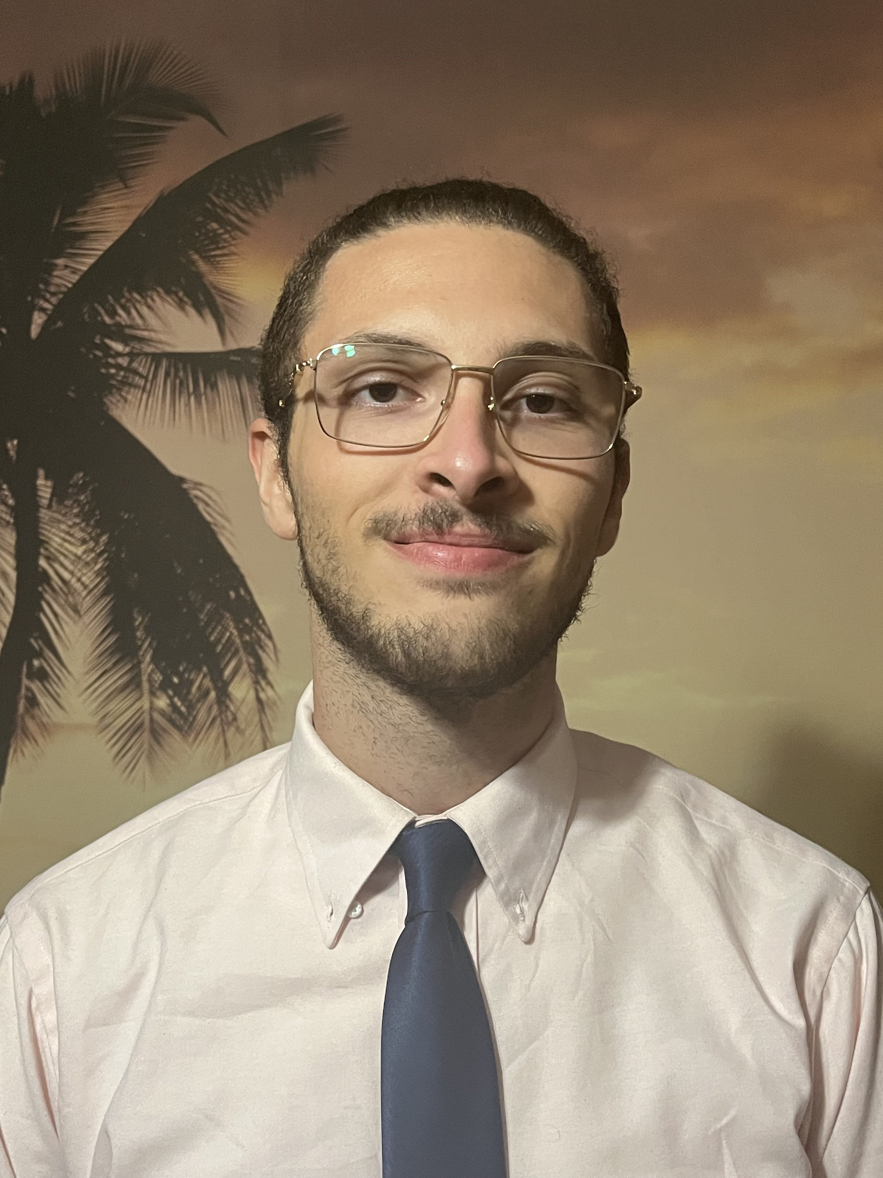

S.W.A.N-U.S.A
Smart Water Bottle with Nutritional Measurements using Spectroscopy
Gonzalo
Gomez –Silva (EE)
Dominic Falvo (EE)
Farris Thrower (PSE)
Rhami Thrower (CS)
Rhami Thrower (CS)

Slide 2
Motivation/Background
Background:
  Reusable water bottles are a staple to society used to reduce waste.
  There are tons of smart bottles on the market. all of which use dual motion or ultrasonic sensor to tell the user how much they drink.
Motivation:
  Enhance the functionality of smart water bottles.
  Incorporate the use of metrology (optics) to provide something never seen in portable water bottles.

Slide 3
Goals
Goals:
  Basic Goal: Design a smart water bottle that can measure liquid contents and reducing sugar concentration with 80% accuracy or more. Develop an app that displays bottle information to users.
  Advanced Goal: Develop methods to increase accuracy to 90% or greater for reducing sugar concentration readings and 85% or greater for water level readings.
  Stretch Goal: Design a bottle that can measure all types of sugar concentrations accurately and have the grams per can measured displayed in the map. Research methods to extend battery life to multiple days.

Slide 4
Basic Objectives
Basic Objectives:
  Use ultrasonic sensor to accurately assess how much liquid an individual drinks.
  Incorporate a touch sensor to have an integrated sleep mode to improve battery life.
  MCU relay info reliably to mobile app via Bluetooth.
  Measure the concentration of Glucose in consumer beverages using spectroscopy.(measure absorption)
  LED alert system to inform users on hydration and nutrition progress.

Slide 5
Advanced and Stretch Objectives:
Advanced Objectives:
  Increase the accuracy of reducing sugar concentrations to be 90% or greater.
  Reduce the size of the spectrometer to fit on slimmer bottles.
  Research/ incorporate different sensing methods for better energy efficiency.
  Add second form of alert system like vibration technology or push notifications.
Stretch Objectives:
  Incorporate new methods to measuring sugar concentration to include non reducing sugars.
  Add a bottle tracking system.
  Research and add methods to extend battery life.

Slide 6
Engineering Specifications
Table 1- System performance specifications
Product Requirements | Requirement Specification | Units
Battery Life needs to be reliable | ≥ 3 | Hours
Bottle weight should be easily handled | ≤ 2 | Pounds
Bluetooth to app response time should be smooth | ≤ 50 | milliseconds
Elapsed time for information update | <5 | seconds
Power efficiency of all components for better battery efficiency | ≥ 40 | percent
Accurate spectral analysis of reducing sugar concentrations | ≧ 80 | percent
Accurate ultrasonic sensor reading for beverage level | ≧ 80 | percent
High signal to noise ratio for adequate optical signal | SNR ≧ 40 | dB

Slide 7
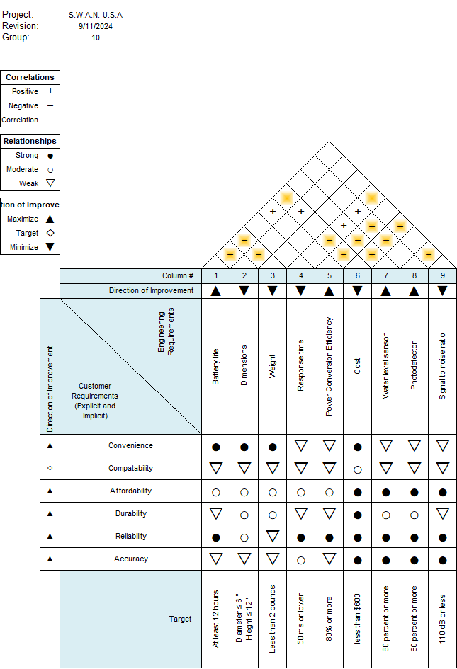
House of Quality
The house of quality is
used to show the relation
between customer and
Engineering requirements.
The HoQ also illustrates the
dynamic between each
component and how it affects
different attributes of the system
Fig. 1 – House of Quality

Slide 8
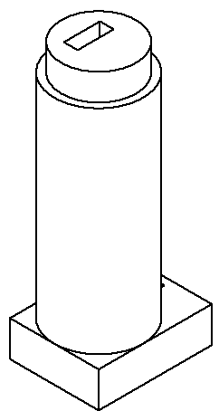
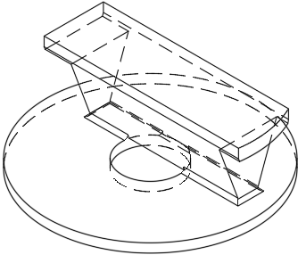
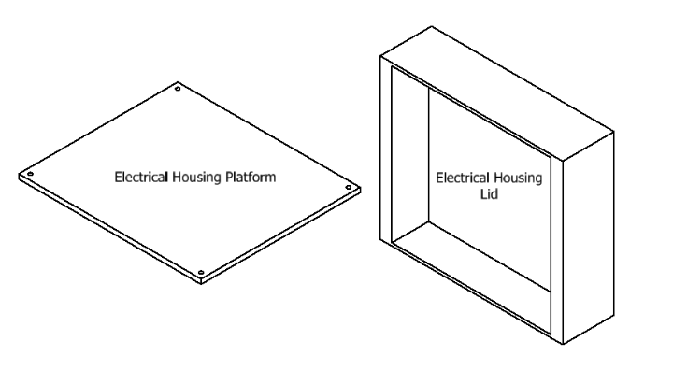
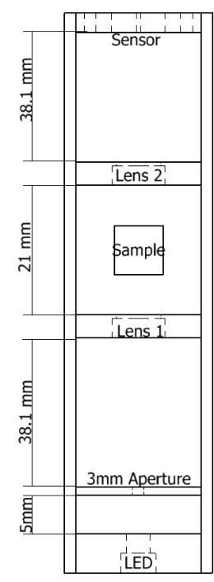
Overall Design
Figure 2 shows our design of
the entire bottle.
Figure 3 shows the water level
sensor mount .
Figure 4 shows the electronics housing that will be at the base of the bottle.
Figure 5 shows the spectrometer sub system housing.
Fig. 3– Image of sensor lid mount
Fig. 4 – Image of electronic housing
Fig. 2 – Image of full Design
Fig. 5– Image of spectrometer housing

Slide 9

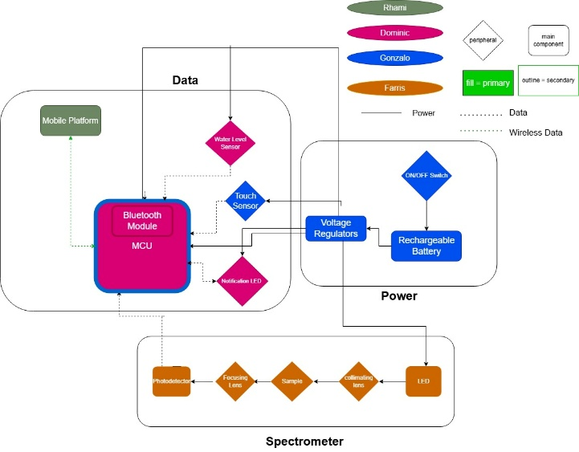



Hardware Block Diagram

Slide 10
Electrical Hardware Comparison & Selection
MCU Comparison and Selection.
Touch sensor comparison and selection.
Water level sensor comparison and selection.

Slide 11
Microcontroller Comparisons
Final Choice is the ESP-32-WROOM
  Plenty of GPIO pins if we needed more
  More than enough computing resources
  Dual Core Processor
  Operates at 3.3V
  Bonus of built in touch sensor
  One of the cheapest options
 | ESP-32 | Nano 33 BLE | MSP430 | Zero 2 W | Pico W | UNO R3
UART | Yes | Yes | Yes | Yes | Yes | Yes
I2C | Yes | Yes | Yes | Yes | Yes | Yes
SPI | Yes | Yes | Yes | Yes | Yes | Yes
Wi-Fi | Yes | Yes | No | Yes | Yes | No
Bluetooth | BLE V4.2 | BLE V5.0 | No | Yes | BLE | No
ADC | Yes | Yes | Yes | No | Yes | Yes
Capacitive Touch Sensor | Yes | No | Yes | No | No | No
Processing Cores | 2 | 1 | 1 | 4 | 2 | 1
Processor Clock Speed | 240MHz | 64 MHz | 16MHz | 1GHz | 133MHz | 16MHz
RAM | 520KB | 256 KB | 128KB | 512MB | 264KB | 2KB
Operating Voltage | 3.3 | 3.3 | 3.3 | 5 | 3.3 | 5
Price | $15 | $25.80 | $25 | $15 | $5 | $27.50

Slide 12
Touch Sensor Comparison
The ESP32 touch sensor gives the most customization.
Does not take up extra space.
No need to add code library.
 | ESP32 Touch Sensor | DIY Touch Sensor | TTP223 Capacitive Touch Sensor | AT42QT1010 Standalone Touch Sensor
Accuracy | High | Low | High | High
Cost | Included with MCU | $14 | $7 for 20 | $5.95
Space | Built-In | Designed into PCB | 14.5mm x 11mm | 20mm x 28mm
Power Draw | Apart of MCU | Unknown | 6µA at idle | 17µA on average at 1.8V
Touch Area Size | Customizable | Customizable | Not Customizable | Customizable
Documentation | Plenty | Adequate | Adequate | Plenty
Sensor Output | Serial | Serial | Digital High | Digital High

Slide 13
Ultrasonic Sensor
Our sensor technology of choice for determining the water level is the Ultrasonic sensor.
Fitting all our requirements is the A02YYUW Sensor.
Although the cost is the highest the waterproofing and great blind zone offsets that con.
 | Voltage | Current | Range | Waterproof | Dimension | Cost
HC-SR04 | 5VDC | 15mA | 2cm-4m | No | 45*20*15mm | $5.00
A02YYUW | 3.3-5 VDC | 8mA | 3cm-450cm | yes | 84*29*12mm | $15.90
JSN-SR04T | 3.3 – 5 VDC | 8mA | 20cm-600cm | yes | 42*29*12mm | $13.00

Slide 14
Optical Hardware Comparison & Selection
Reducing sugar reaction comparison and selection.
Light source comparison and selection.
Collimating lens comparison and selection.
Focusing lens comparison and selection.
Light sensor comparison and selection.

Slide 15
Reducing Sugar Reaction
Sugar Reaction Comparison
Reaction Type | Availability | Integration | Wavelength
DNSA | Have | Easy | 580 nm
Hexokinase | Can order | Requires ATP | Ultraviolet
Horseradish Assay | Can order | Nonvisible light | Ultraviolet
DNSA tests had good results
Horseradish assays can be made
In the lab
We chose DNSA, because
we were able to acquire the
chemicals needed in less
then two days.

Slide 16
Light Source
Light source
Spectral emission of desired wavelength.
Efficient optical power.
Small viewing angle.
Low cost.
Light emitting Diode | Laser diode
Broadband light source | Narrowband Light source
Polychromatic | Monochromatic
Attenuation due to dispersion | Less attenuation
2-15mW optical power | 10 mW – 500 mW optical power
Cheapest option | Get what you pay for
LED Comparison & selection
company | Product # | Wavelength range (nm) | Optical power (mW) | Viewing angle | Max DC forward current (mA) | Price
Thorlabs | LEDWE-15^{d} | 430 - 660 | 13 | 7.5 | 30 | 10.92
Thorlabs | LEDW7E | 430 - 660 | 15 | 7.5 | 30 | 8.76
Thorlabs | LEDW25E | 430 - 660 | 15 | 25 | 30 | 9.09
Thorlabs | LED591E | 590 | 2 | 10 | 50 | 21.86

Slide 17
Collimating and Focusing Lenses
Lens vs.Mirror
Lens | Mirror
Any focal length | Any focal length
Transmission | reflection
30 - expensive | 50 - expensive
Lenses
Company | Product # | Material / coating | F/# | NA | Diameter | Focal length | Price ($)
Thorlabs | LA1116 | N-BK7 /uncoated | N/A | 6 mm | 10 mm | 24.12
Thorlabs | LA1222 | N-BK7 /uncoated | N/A | 6 mm | 15 mm | 22.56
Newport | KBX031 | N-BK7 /uncoated | 3 |.16 | 12.7 mm | 38 mm | 37.00
Newport | KPX046 | N-BK7 /uncoated | 3 | .16 | 12.7 mm | 38 mm | 33.00
Edmund Optics | #37-801 | N-BK7 /uncoated | 1.57 | .32 | 12.7 mm | 20 mm | 29.00
Lenses and mirrors act similarly.
Mirrors are not susceptible to chromatic aberration.
Lenses focus light at different points depending on wavelength.

Slide 18
Light Sensor
Photodiode | Linear Photodiode Array | CMOS sensor
Small detection area | Long detection area | Large detection area
Cheap | Expensive | Cheap - Expensive
Easily integrated | Hard integration | Easy integration
.3 A/W response | .3 A/W response | Sensitivity dependent on wavelength
60dB (theoretical) | 100dB (theoretical) | 40dB (datasheet)
Light sensor
Company | Product | Range(nm) | Active area (mm)² | Responsivity (A/W) | Price ($)
Thorlabs | FDS10x10 | 350-1100 | 100 | 0.725 | 220.95
Hamamatsu | S14833 | 340-1100 | N/A | 0.68 | N/A
Edmund Optics | #53-378 | N/A | 100 | 0.65 | 138.00
Adafruit | TSL2591 | 400-1100 | 56 | 0.6 | 6.95
ESP | OV2640 | 380-1100 | Adj. | 0.6 | 26
Light sensor selection
Small pixel size .
Responsivity to visible wavelengths.
Ease of integration .
Must have i2c capability.
Price.

Slide 19

Battery Selection
For the portability of our water bottle the usage of batteries is required.
For safety in the lab the use of Li-ion batteries are the choice for the project.
The 18650 Li-ion Battery is the battery of choice
Most batteries on our table suit or design needs but are unprotected compared to the 35E from Samsung
 | Voltage | Discharge current | Capacity | Topology | Size | Cost
EEMB 103454 | 3.7V | 400mA | 2000mAh | LiPo | 8*56.5*60.5mm | $12.99
Mikroe MLP805660 | 3.7V | 600mA | 3000mAh | LiPo | 55*34.5*10mm | $17.40
LP675365JU | 3.7V | 600mA | 2800mAh | LiPo | 68*54*7.2mm | $17.80
LP906090JH | 3.7V | 1200mA | 6000mAh | LiPo | 93*60*9mm | $23.64
35E | 3.7V | 8000mA | 3500mAh | Li-ion | 18.42*66.92mm | $7.09

Slide 20
Power System Regulator Comparison & Selection
 | Voltage | Efficiency | Simplicity (BOM cnt.) | Topology | Footprint | Cost
LM317L | 3.3VDC | 50% | 5 | Linear Regulator | 20mm^2 | $0.60
TPS61023 | 3.3-5 VDC | 90% | 7 | Boost Passthrough/ Boost | 102mm^2 | $0.73
TPS63021 | 3.3 VDC | 83.8% | 6 | Buck-Boost | 47mm^2 | $1.24
TPS61022 | 5VDC | 94.9% | 7 | Boost passthrough | 99 mm^2 | $1.08
TPS630252 | 3.3VDC | 92.2% | 5 | Buck-Boost | 93 mm^2 | $1.24
LM1117 | ADJ or Fixed at 3.3V and 5V | 60% | 3 | LDO/ Linear Regulator | 20mm^2 | $1.24
ADP3338 | ADJ or Fixed at 3.3V and 5V | 90% | 3 | LDO/ Linear Regulator | 20mm^2 | $3.50
Linear Regulator technology is selected
  Simple 3 components required to function.
  Not as susceptible to noise.
  Should not affect battery life too much as our battery capacity is high (3500mAh).

Slide 21
Summary of Hardware Selection
Selected Hardware
Microcontroller | ESP32-WROOM
Battery | 35E Samsung 3500mAh
Ultrasonic sensor | A02YYUW
Touch sensor | Built in ESP32-WROOM
Notification Peripheral | LED
Spectrometer LED | Thorlabs LED591E
Lenses | L1 Newport(KPX046) L2Newport(KBX031)
Light sensor | TSL2591

Slide 22
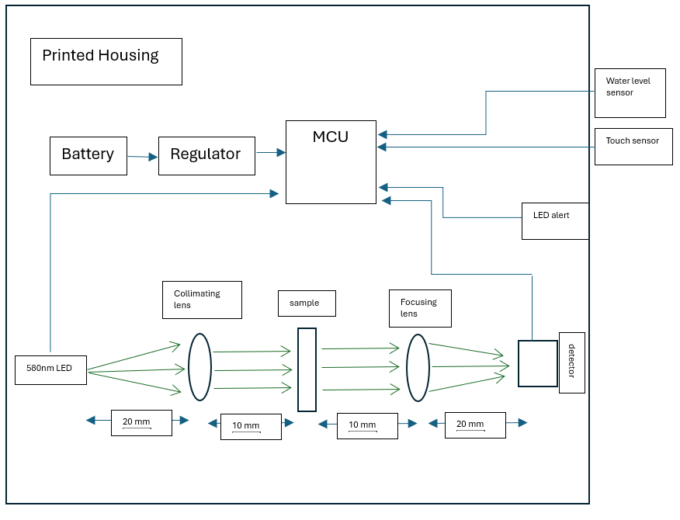
Design Schematic

Slide 23
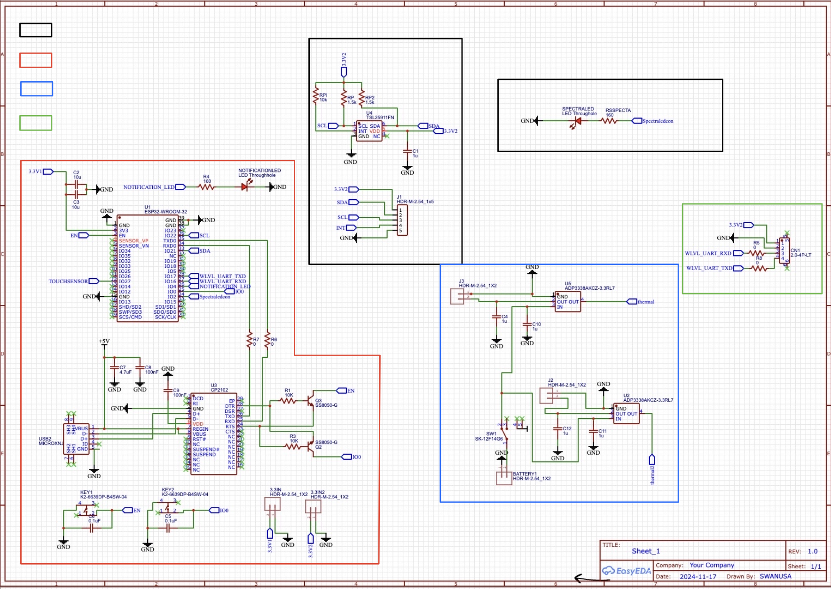
PCB Schematic
Legend
Spectrometer
Light Sensor
Main PCB
LED for Spectrometer
Power supply
Ultrasonic sensor
Ultrasonic
Power Supply
Main

Slide 24
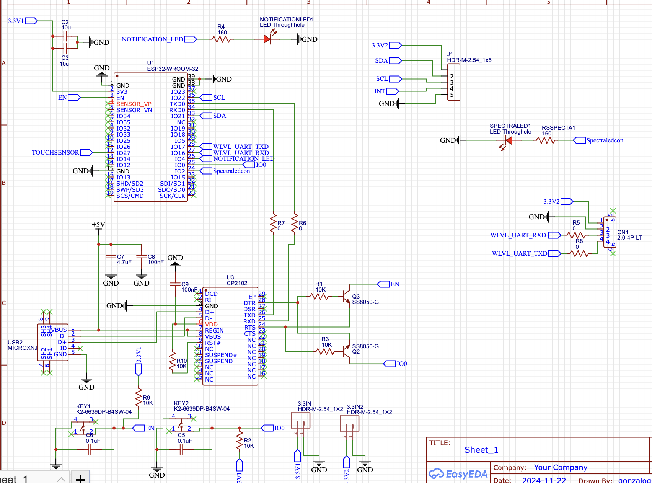
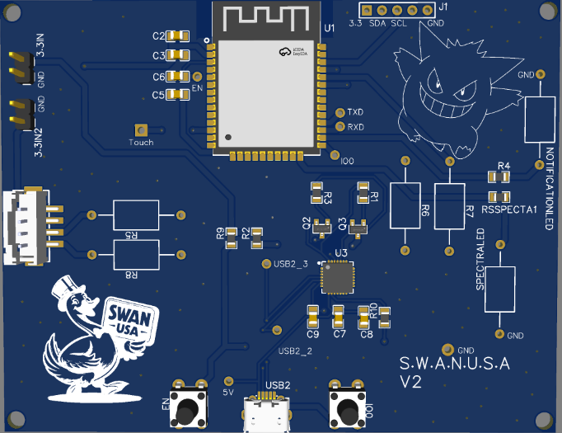
Main PCB Layout

Slide 25
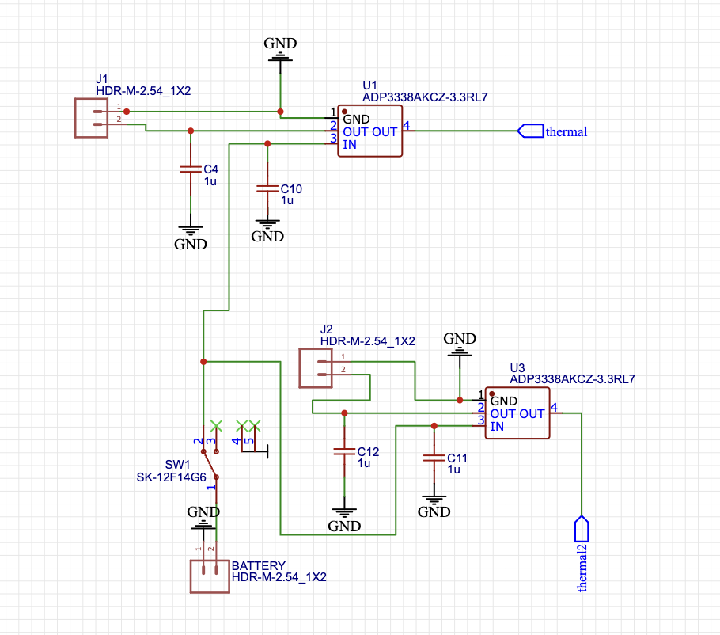
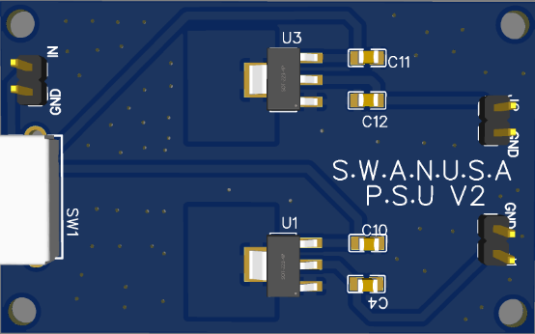
Linear Regulator Layout

Slide 26
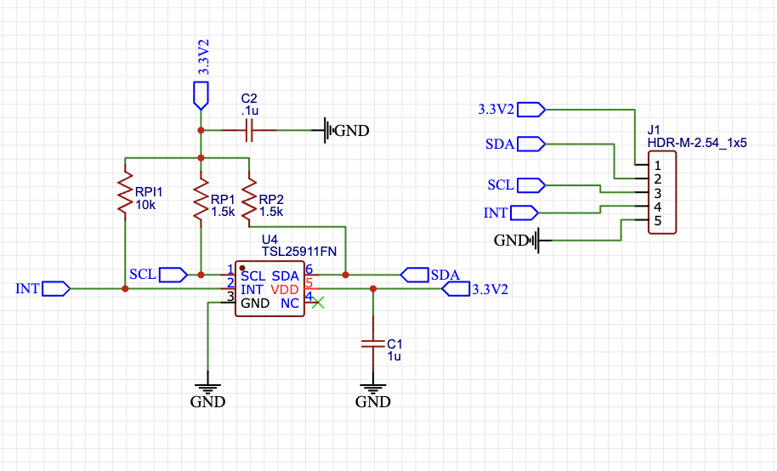
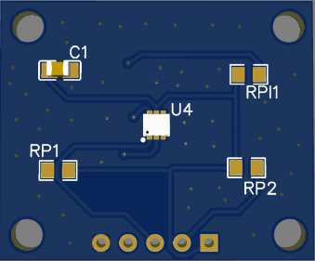
Light Sensor Layout

Slide 27
Functionality Testing Results
All PCBs worked flawlessly; we did a version 2 board to finalize the boards appearance.
Water level sensor had some issues accurately reading water level.
  Precise positioning and a flat surface fixed reading issues.
Integration of peripheral functions with the touch sensor required trial and error.
Sub system spectrometer had 2x the SNR we wanted.
Reducing sugar concentration tests were challenging. The margin for error in synthesizing the solution and in the readings really affect accuracy.

Slide 28
Final thoughts on Hardware Design
Hardware functions well together.
Full integration of the system was relatively smooth.
We would have liked more time to make more revisions to the electronics housing.
The spectrometer functions well and gives us accuracy of sugar concentration readings within an acceptable range.

Slide 29
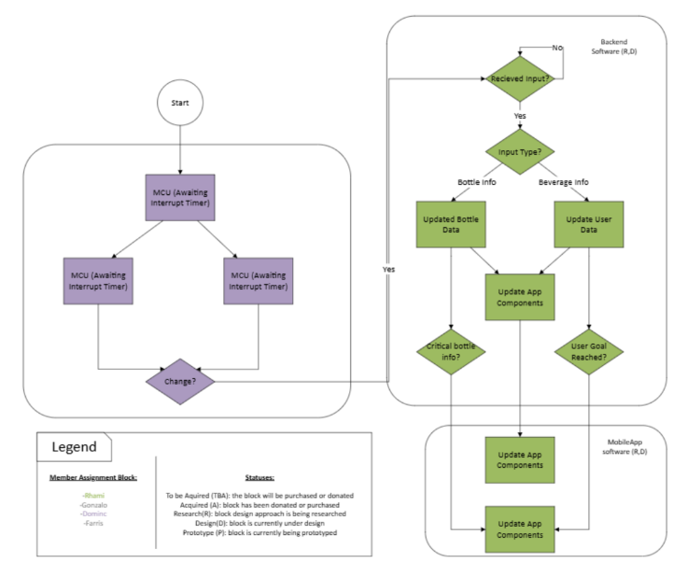
Software Block Diagram

Slide 30
Full Stack Development Software Selection
Front end software comparison and selection .
Back-end software comparison and selection.
Communications comparison and selection.

Slide 31
Front - End
What does the Front-end do?
Why are these factors important?
  Cross platform
  Language
  API's (android, iOS)
  UI/widget customization
 | Flutter | Kivy | React Native
Cross Platform | Y | Y | Y
Language | Dart | Python | JavaScript
Difficulty | High | Low | Medium-High
Runtime | Fast | Slow | Fast
Customization | High | Low | High

Slide 32
Back end
What does the Back-end do?
Why are these factors important?
  Scalability
  locality
  Cost
  Functionality (base feature)
Other benefits
  Ease of use
  Testing
  Functionality (additional feature)
 | Firebase | AWS
Scalability | Vertical & horizontal | Vertical & horizontal
Locality | Many servers via Google | Many local servers
Cost | Low | Low
Databasing | Many Options | Many options
App deployment | Offered(hosting, storage, authentication) | Offered(hosting, storage, authentication)
App testing | Yes | Yes
Extra Features | Moderate extra features | Many extra features

Slide 33
Wireless Communications
 | Bluetooth | Wifi
Security | Weaker (no encryption) | Stronger (encryption)
Connectivity | Shorter range, slow speed | Longer range, faster speed
Ease of use | Easier( for developer and user) | Harder (for developer and user)
Power Consumption | Lower | Higher
Notes:
Bluetooth being almost a industry standard played a major role in its selection
Ease of use also(Dash cam and washing machine challenges/ needing to establish server like connection for data sharing)
Emphasize power consumption

Slide 34
Software Selection Summary
Final software selection
Front-End | Flutter
Back-End | AWS (Amazon web services)
Wireless Communication | Bluetooth(Bluetooth low energy "ble")
Back-end extended
Lambda | Used for generating graphs(used external from user)
DynamoDB | Used for storing beverage data
S3 | Used to store generated tables
Amplify | Used for user auth

Slide 35
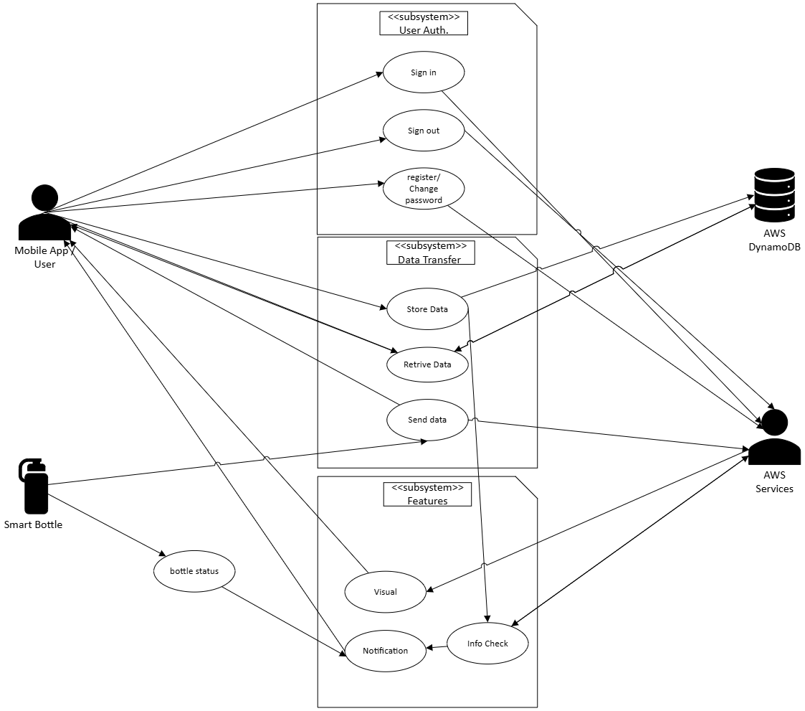
Use Case Diagram
Four actors
  User (via mobile app)
  Bottle
  AWS DynamoDB( our database
  AWS services(other AWS services)
Three base features outlined
  User Authentication
  Data transfer
  Alt. featrues

Slide 36
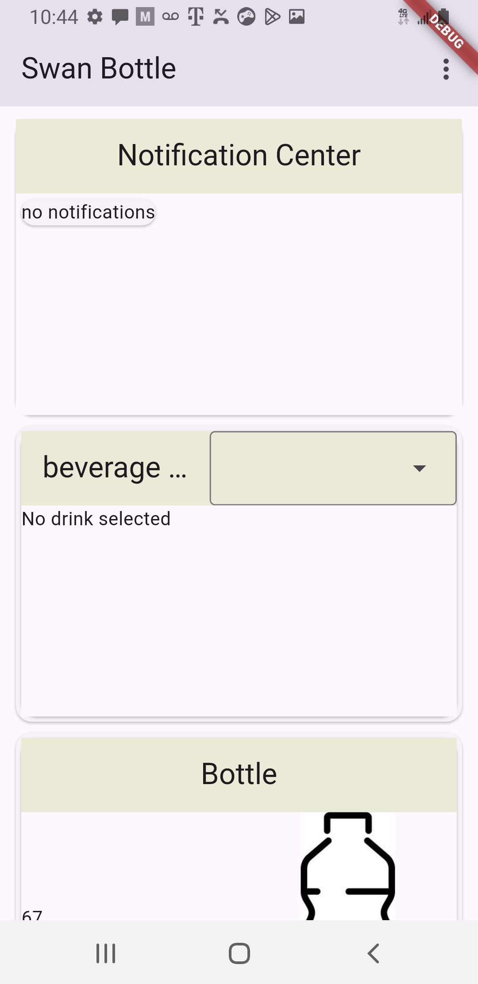
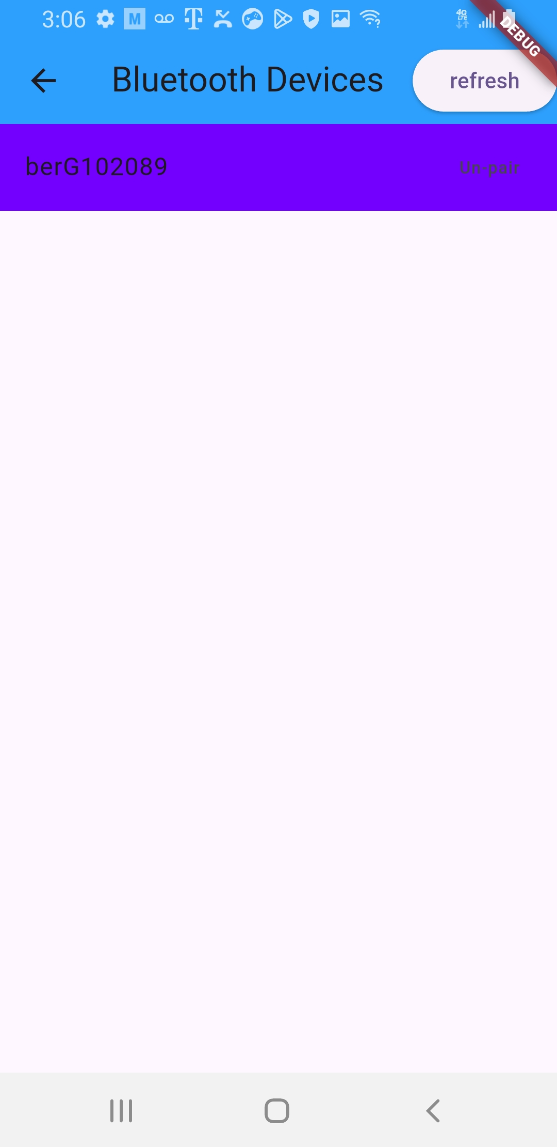
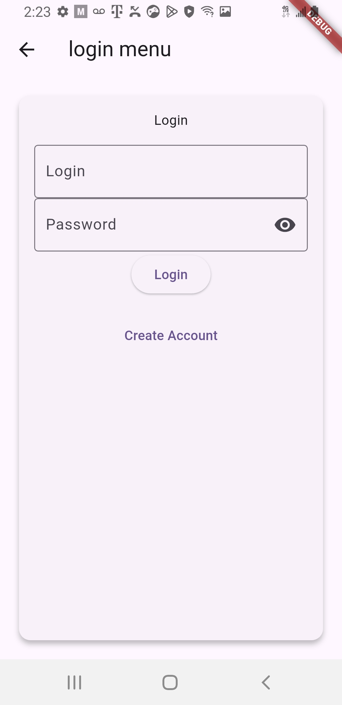
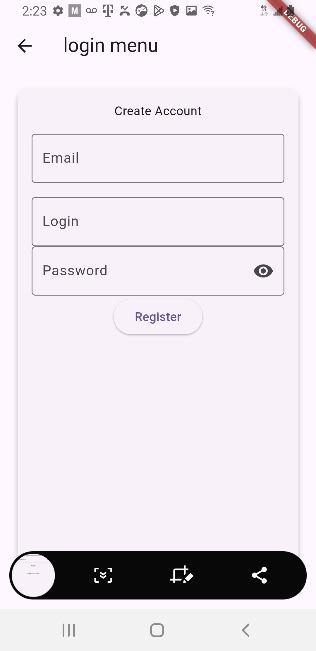
UI Design
App design:
  Zones
    3-6 zones
  Widgets
    Current beverage consumption
    Table Data
    Beverage info
    Notifications
    Sugar Conecentration

Slide 37
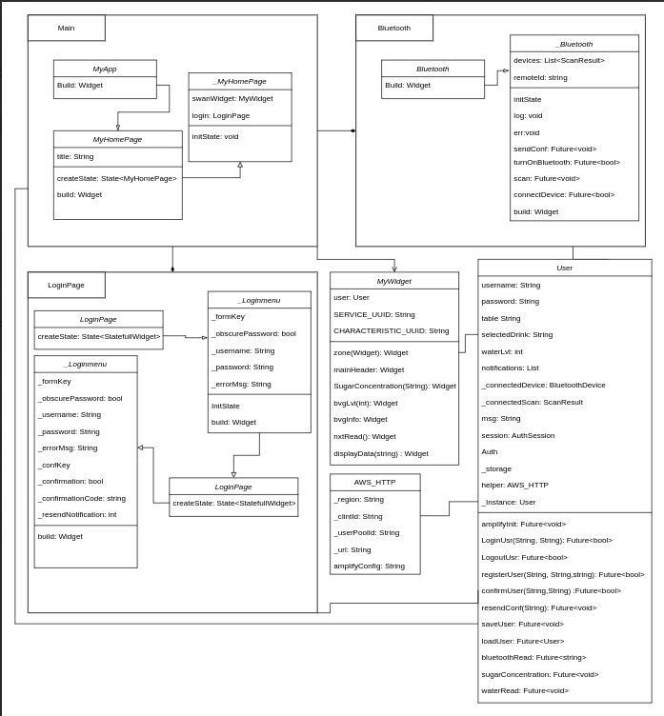
Class diagram
Used to help make code more readable
Breaks off mobile-App elements for potential user customization.
Makes debugging easier

Slide 38
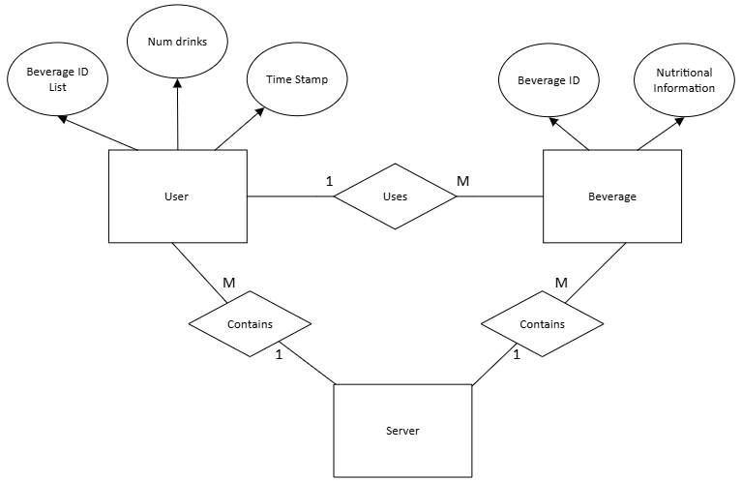
Database Design
Two distinct databases:
  One for beverage info
  One for user info (will be implemented in future update)
Partitioning:
  User
    Primary: user ID
    Secondary: Beverage name
  Beverage
    Beverage name
Must be used in tandum!!!

Slide 39
Full Stack Development Results & Final Thoughts
we hate mobile app development
All the features are working adequately together but not in an optimal fashion.
  Widgets must be updated via screen rotation or user input.
If we had more time, we would have been able to fix some of these minor bugs and been able to implement a more unique UI.
The front-end to back-end connection was the greatest struggle for the development of the app.
Other than that, the app works well.

Slide 40
Budget
Component | Subsystem | Quantity | Cost
Electrical
ESP32 Dev Kit | ALL | 1 | $15
Battery | PSU | 2 | $24.80
Ultrasonic Sensor | Water Level | 1 | $30.86
LED | Notification | 1 | $1.80
PCB Components
PCB | ALL | 1 | $160
3.3V Voltage Regulator | PSU | 4 | $15
CP2102 UART-USB Bridge | MCU | 1 | $3.53
ESP32-WROOM-32 Chip | MCU | 1 | $4.23
USB Micro Female | MCU | 1 | $0.34
JST 2.0 4 pin | Water Level | 1 | $0.45
MISC (Capacitors and resistors) | PCB | 1 | $8

Slide 41
Budget
Hardware
Battery Holder | PSU | 1 | $18
Bottle | ALL | 1 | $20
Heatsinks | PSU | 1 | $12.77
Spectrometer Components
LED | Spectrometer | 1 | $8.97
Collimating/ focusing Lenses | Spectrometer | 2 | $30 each
Photodetector | Spectrometer | 1 | $6.59
Sample vial (cuvette) | Spectrometer | 1 | $9.51

Slide 42
Work Distribution
Electrical Engineer | Main Responsibilities
Dominic Falvo | MCU Selection and Programming Touch Sensor Selection and Design Secondary PCB Designer Project Lead
Gonzalo Gomez-Silva | PSU Selection and Design Primary PCB designer Secondary MCU Programmer Notification LED Design
Computer Science | Main Responsibilities
Rhami Thrower | Front-End Software Design Back-End Software Design Server setup Database setup
Optics Engineer | Main Responsibilities
Farris Thrower | Spectrometer Component Selection and Design Co-Project Lead

